Slide 1
NORTHEAST ALBERTA FOOD MARKETERS ASSOC
Web Site, Toolkit & Vendor Portal

Slide 2
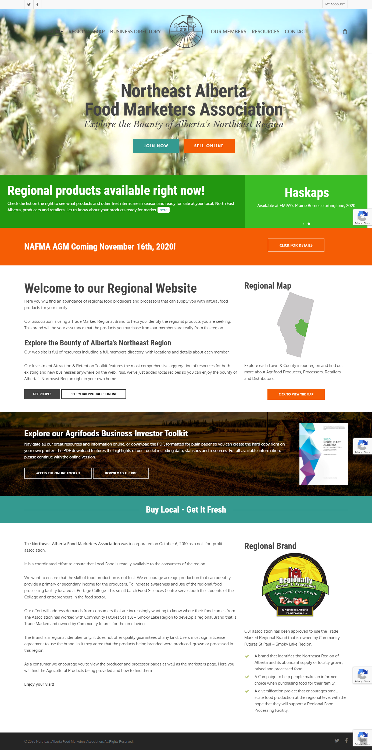
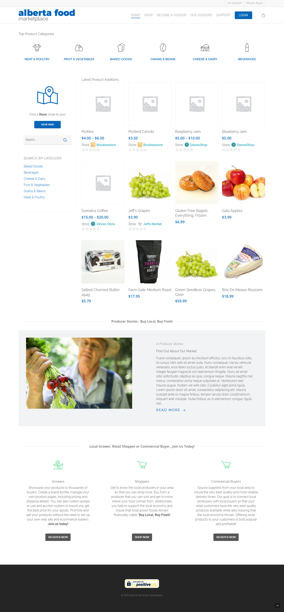
Web Site
Toolkit
Vendor Portal

Slide 3
NAFMA Web Site
The purpose of the NAFMA web site is to promote the organization, layout the benefits of the organization and provide all site visitors with access to resources that they can use to start, promote and grow their business.
Site Features:
A comprehensive business directory featuring 197 local agri-food businesses.
Each business has been categorized and mapped
A full member listing with profiles
Download PDF of the NAFMA Investment Retention and Attraction Toolkit
The online version of the toolkit
A comprehensive and exhaustive list of Resources for agri-food businesses at all stages of development
First stage or promoting our online vendor portal
Visit https://www.nafma.ca

Slide 4
Investment Retention & Attraction Toolkit
The toolkit was created to become the singular resource for the agri-food industry. It contains not only regional information, statistics and demographics, but the most comprehensive list of resources, agencies and opportunities anywhere in the Province of Alberta.
Toolkit Highlights:
A comprehensive overview of the regions demographics and a detailed look at the business environment with a focus on agri-foods
Data analysis of the Northeast Alberta Agri-food Survey. Raw data and interpretation of the feedback received during this survey
Details of existing opportunities in the industry
Introduction and links to business support services, programs for growth, food science and innovation facilities, funding resources and key government agencies
Local and export market analysis

Slide 5
Visit https://www.albertafoodmarketplace.com
NAFMA Vendor Portal
Branded as the Alberta Food Marketplace, this portal will offer agri-food producers the lowest possible barrier platform to sell their goods online. Essentially, this online store is a collection of individual vendor stores who can sell their products direct to buyers, and can also see their products aggregated with other producers to create huge marketing potential .
Site Features:
Individual agri-food store, secure and ready for sales.
Integrated with Google Maps so that buyers can navigate to the real world business location
Secure sales environment with Stripe so that no credit card information is saved on our servers
Integrates with existing FedEx and UPS shipping calculators for automatic shipping charges. Or the vendor can set their own pricing, including “Local Pickup Only”
Complete training including onboarding of the vendor and continuous tech support
Online vendor partnerships available for the ultimate cross-marketing opportunities

Slide 6
Where We Are At
Each of our projects are at different stages and here is an overview of where we are.
NAFMA Web Site
The web site was originally constructed in 2017. It is being hosted and maintained at this time with all proper security updates. The content is being updated regularly for timeliness but we currently do not have anyone assigned for content additions.
NAFMA Toolkit
The toolkit was recently updated, however much of the data that it draws on was collected in 2017. For example, our agri-food survey was completed in late 2016 and the toolkit first compiled in 2017. The balance of the data relies on sources that may not regularly update. However, a review of all data sources was recently completed and those few changes are reflected in the latest downloadable PDF and the online version of the toolkit.
NAFMA Vendor Portal
This web site is fully operational and we have staff in place trained and ready to onboard vendors to the program. A marketing plan has been discussed and there are one or two outstanding administrative points to address.

Slide 7
THANK YOU
Time for questions!

